Slide 1

CRO Strategy Review
June 2021
Author: REO
Notes:
.

Slide 2
CRO Strategy Review
Why are we doing this?
Existing add-ons journey (new control)
Deep dive into each add-on
MLP
Hire Car
Personal Injury Benefit
Breakdown Cover
Cognitive Bias, Customer Decision Styles & IDD
Priorities for test ideas
Next Steps
Contents
Notes:
Ask everyone to write down ideas and insights as we go to have ready for ideation session next week

Slide 3
Approach
Why are we doing this?
1.
ASR per sale has dropped by at least £8 since IDD changes rolled out
2.
(Stretch) target of £6 incremental ASR per sale by end of the year

Slide 4
Current Activity: ASR per sale

Slide 5


Our customer strategy on-a-page: Based on our current distribution model, the below is how we can optimise our overall customer experience and business performance
Competitor Analysis Overview – Optional Ad Ons
89% of competitors analysed show price upfront before any CTA interaction
Competitor | Price shown upfront | Need statement shown | One Set of CTA to choose product | Action required (eg button click) to est. Need | Requirement to interact (select Yes/No)
LV
Aviva
Admiral
Hastings
More Than
Churchill
The AA
First Central
AXA
8 out of 9 of the competitors analysed show a need statement
77% of competitors analysed only have one set of CTAs and do not force users to view more information before product selection
Only 22% of the competitors analysed require a button click to establish a need before a user can select a product
77% of competitors analysed ensure the user selects Yes/No and do not make the add on products skippable
Notes:
Esure carried out some analysis around how competitors are displaying add ons with the new IDD changes
Run through key takeaways on the right
Off the back of this research plus other insights from user testing the following changes to the control are being rolled out / tested…

Slide 6
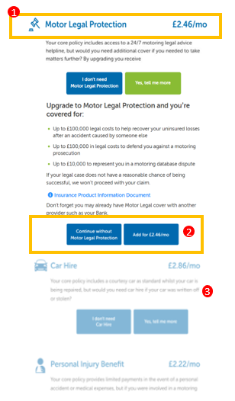
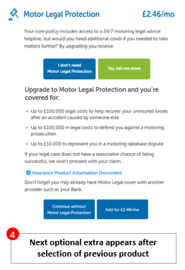
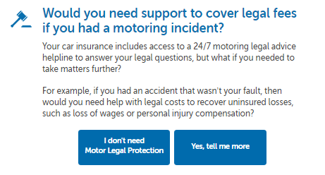
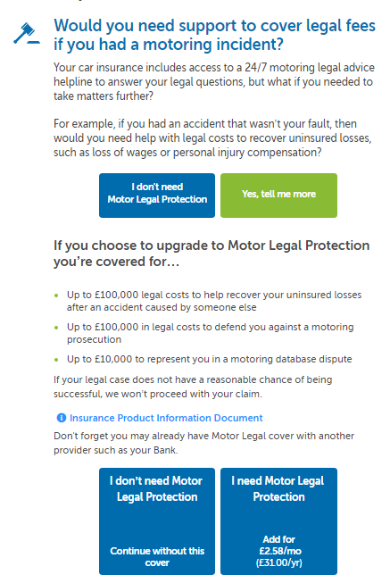
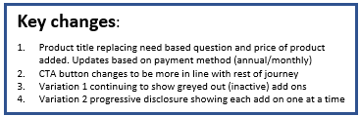
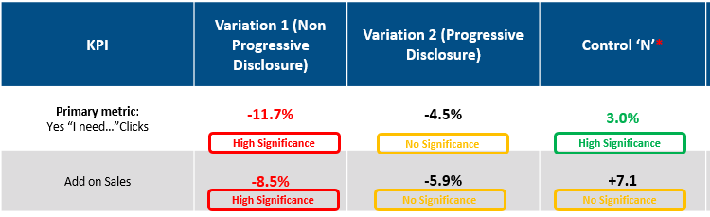
Price and Title Add on Test
Goal: ASR per sale
Control
Variation 1
Variation 2
Hypothesis.
We hypothesize that by leading with the price and product title for optional extras, users will see that the optional extras are not to expensive and therefore help them assess their need for the product ad therefore increase “Yes” clicks for the optional extra and overall add on sales
Results
What we learnt
Although we saw a decrease in traffic clicking “Yes, Tell me more” for both variations, this is due to users for the control group clicking through purely to find out the price and therefore inflating the clicks on the initial CTA.
Once a user had clicked through we saw increased take up for both variations. This indicates the initial need based question is a potential barrier when the price is shown as they want to see product benefits upfront with the price
+2%pt
Increase in MLP “I need” clicks once user expresses an interest
+10%pt
Increase in PIB “I need” clicks once user expresses an interest
+12%pt
Increase in Car Hire “I need” clicks once user expresses an interest
Notes:
Testing a simple title for the add on with the price shown upfront increased take up of the add on once the user had expressed an initial interest in the add on
Noted that the progressive disclosure performed better than the non progressive disclosure

Slide 7

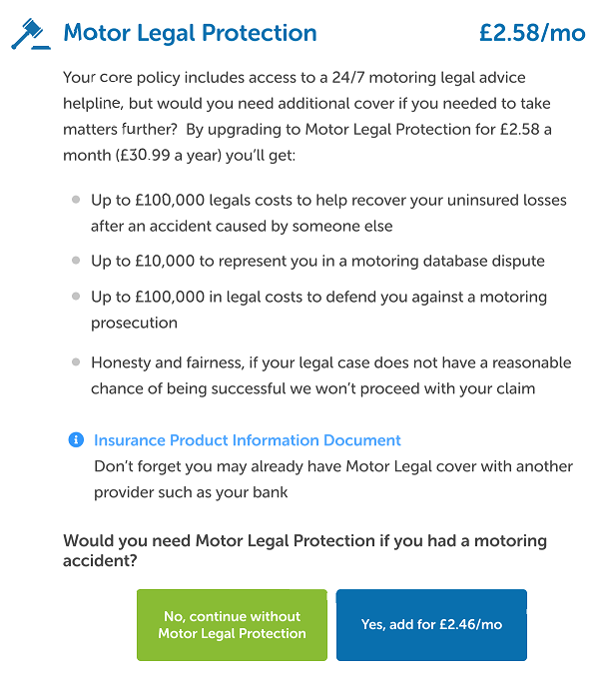
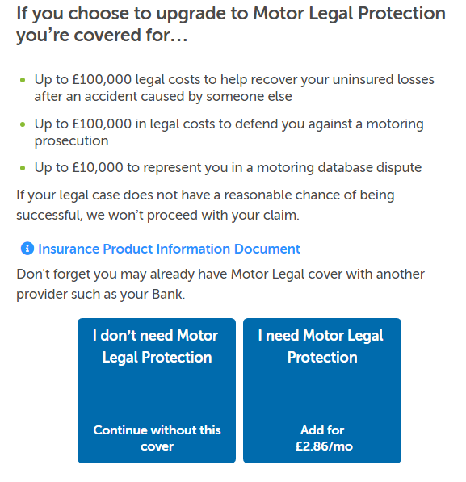

Goal: ASR per sale
Esure Add on redesign
Control (MLP example)
ES New design (MLP Example)
Description
1
Following our initial test for the price and title test, it clearly showed that once the users expressed an interest in the product (and therefore digested more information) increased users selected the product. This design has taken this insight into account along with user testing insights to have more information upfront and one set of CTAs
Expected Go Live Date
2
Key changes:
Product title replacing need based question and price of product added. Updates based on payment method (annual/monthly)
One set of CTAs for user to establish their need of product easier
Notes:
This design change will be rolled out on esure to incorporate the learnings from the test in the previous slide (showing a simpler title and price) plus insights from user testing and the competitor research around only having one set of CTAs.

Slide 8
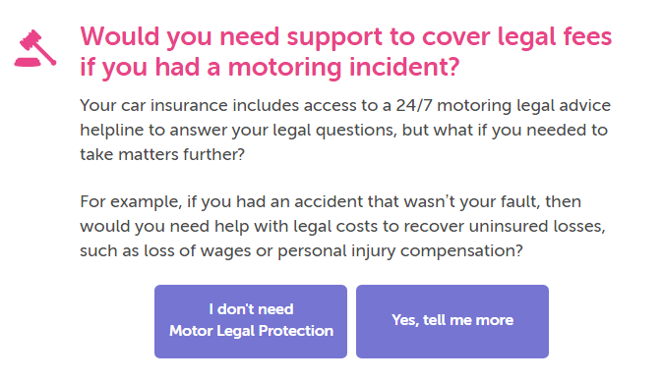
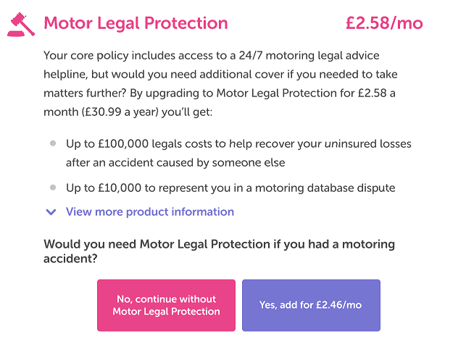
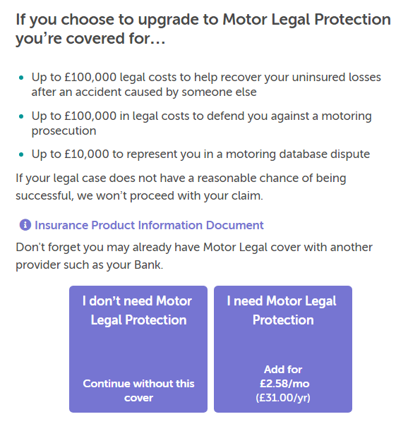
Goal: ASR per sale
Sheilas’ Wheels Add on redesign
Control (MLP example)
SW New design (MLP Example)
Description
1
Following our initial test for the price and title test, it clearly showed that once the users expressed an interest in the product (and therefore digested more information) increased users selected the product. We are showing SW users a different design (dropdown) to see what design is stronger and whether is better across different devices
2
3
Key changes:
Product title replacing need based question and price of product added. Updates based on payment method (annual/monthly)
Dropdown giving the option for users to see further information after showing key bullet points of product benefits
One set of CTAs for user to establish their need of product easier
Expected Go Live Date
Notes:
A different version of the add on redesign will be rolled out on Sheila’s Wheels where some key information is hidden behind a dropdown.
NOTE: we have this in the prelaunch section – what is the latest on getting this and the previous one live?
Will this have progressive disclosure? I couldn’t see any note mentioning this.

Slide 9
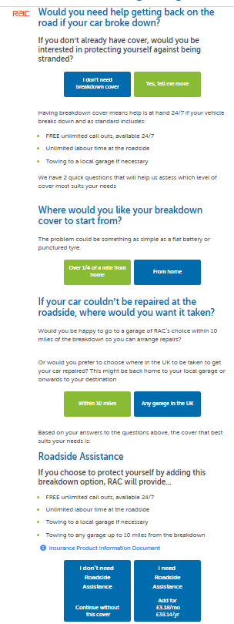
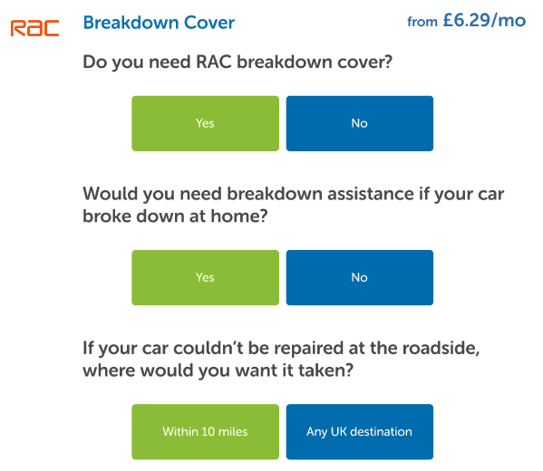
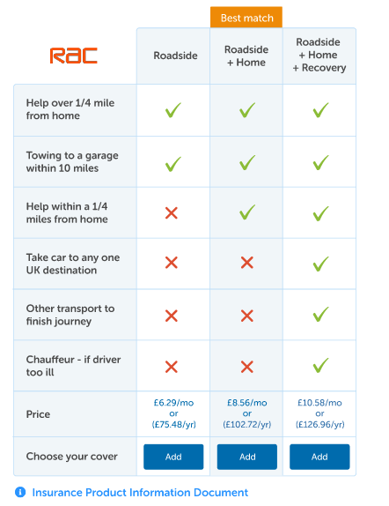

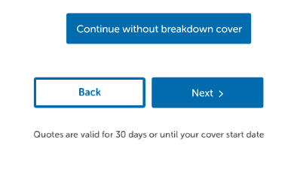
Goal: ASR per sale
Breakdown Comparison Table
Control
New design
(pending sign off)
Description
User testing indicated that comparison tables were a lot easier for users to understand what is covered in the breakdown product. In addition to this, competitor analysis also shows 78% for analysed competitors show a comparison table in some form. Therefore we are currently working on adding a breakdown comparison table that is IDD compliant into the Motor PCW journeys
1
2
3
Estimated Go Live Date
Key changes:
Product and dynamic pricing shown upfront
Users have to answer all questions (progressive disclosure) before interacting with the table
Breakdown table shown upfront
Notes:
The breakdown comparison table will also be rolled out to make it easier for users to understand and compare breakdown options.

Slide 10
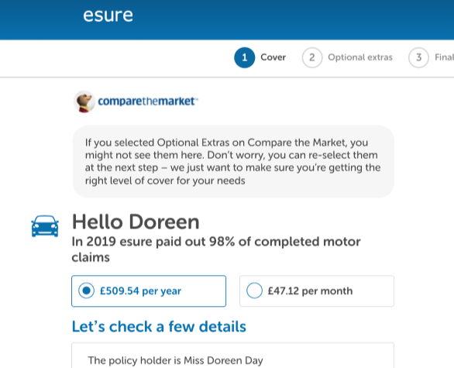
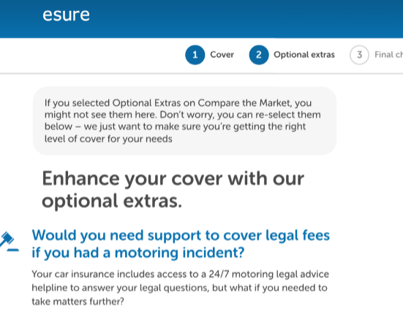
Add on Prompt
Goal: ASR per sale
Variation 1
Variation 2
Message added to prompt users to re-select their add ons.
V1 – message appears on the Quote page
V2 – Message appears on the Optional Extras page
CURRENTLY LIVE
Evidence As we are aware, at present if a user adds optional extras in the PCW journey, when they come to our site, the selections are not carried over and therefore the customer needs to reselect them. Therefore, to help blueprint strategy and help Add on take up in current journey, we want to see whether by adding a prompt on quote page / optional extra page increase ASR per Sale.
Hypothesis
We hypothesize that by adding a prompt to users after entering our site from the PCW, users will feel less anxious if they do not see their optional extras selections that they selected in the agg, and therefore will add them in the esure journey, increasing conversion and ASR per sale.
Notes:
We also have this test live at the moment to address the issue around users having to reselect their add ons after they have arrived from an aggregator.

Slide 11
Current Add-ons Journey

Slide 12
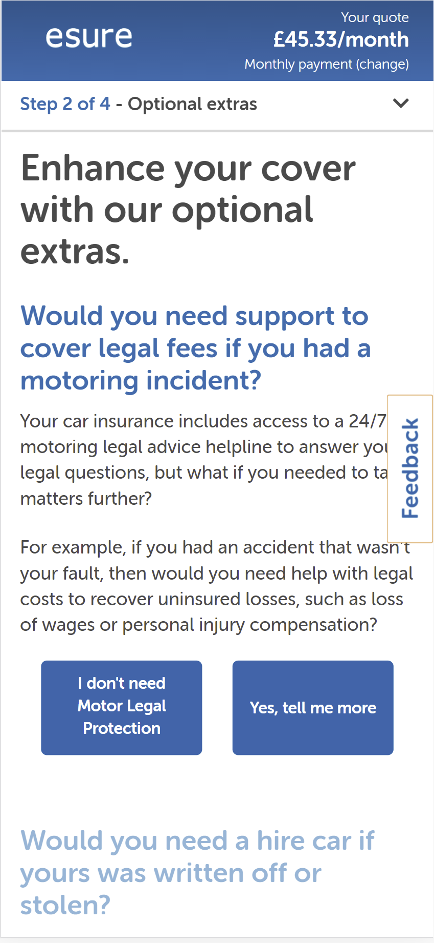
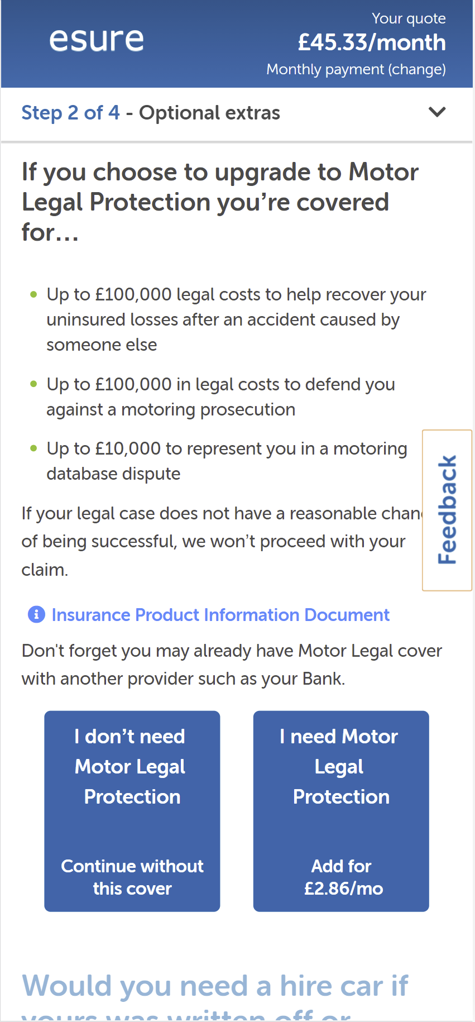
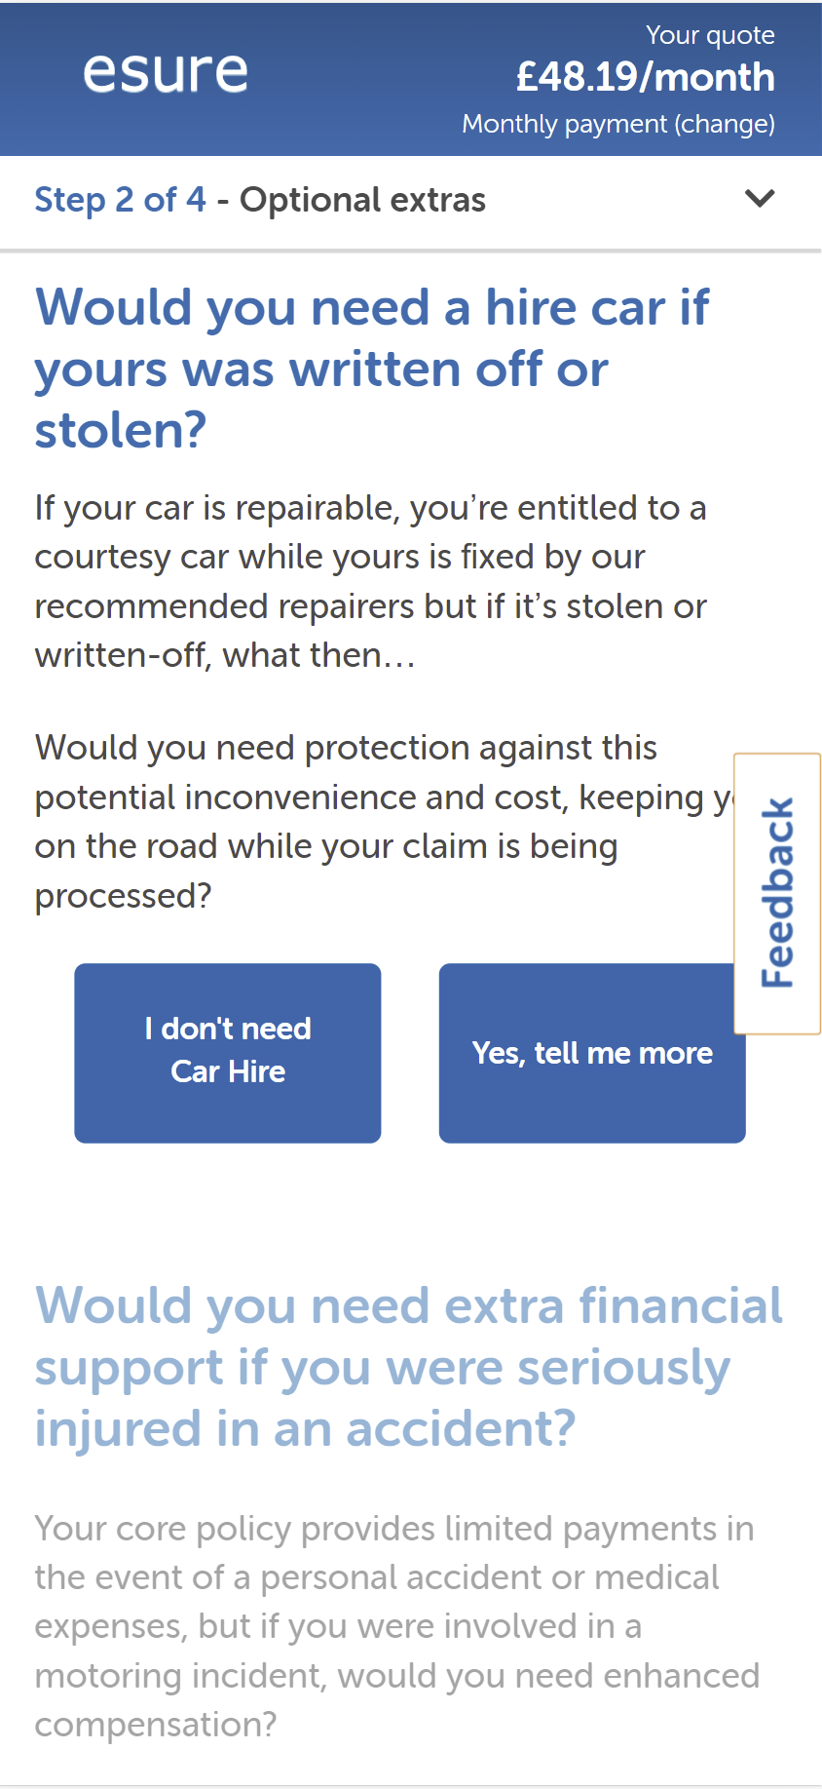
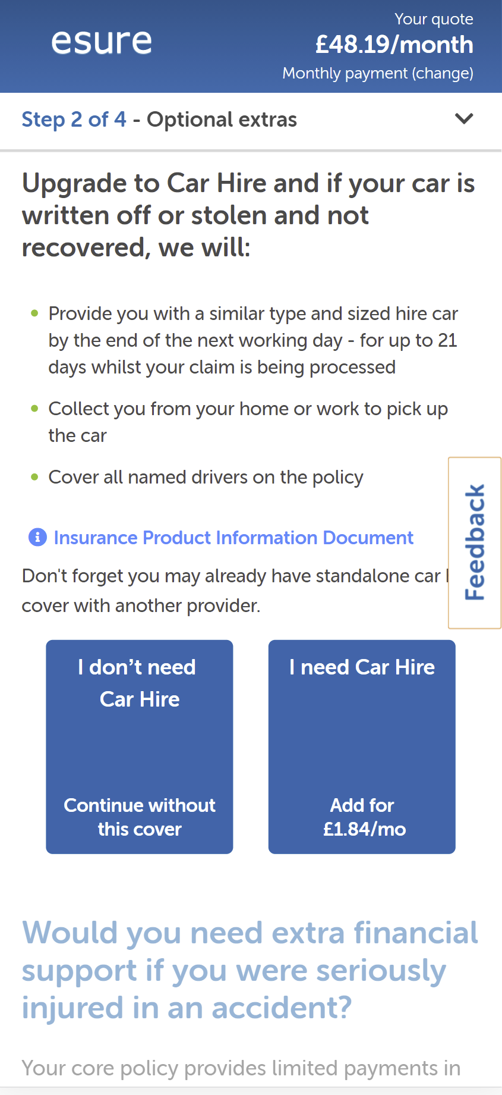
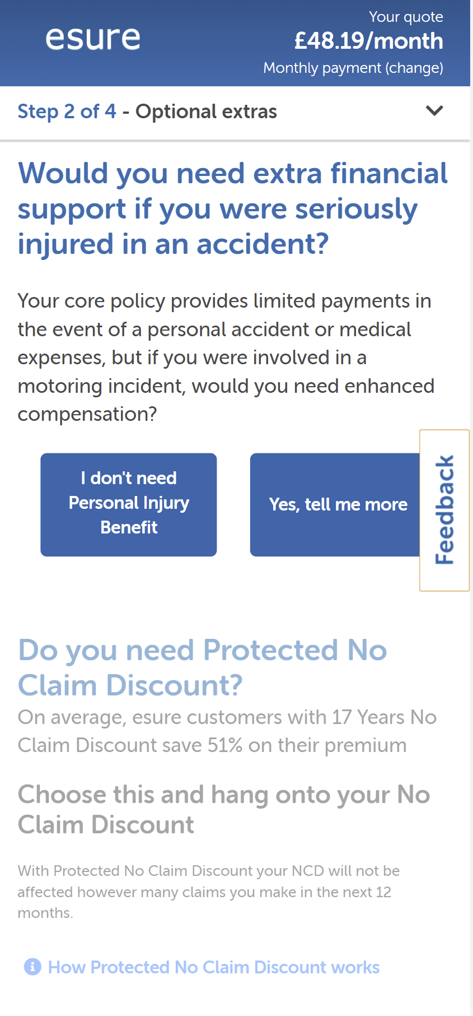
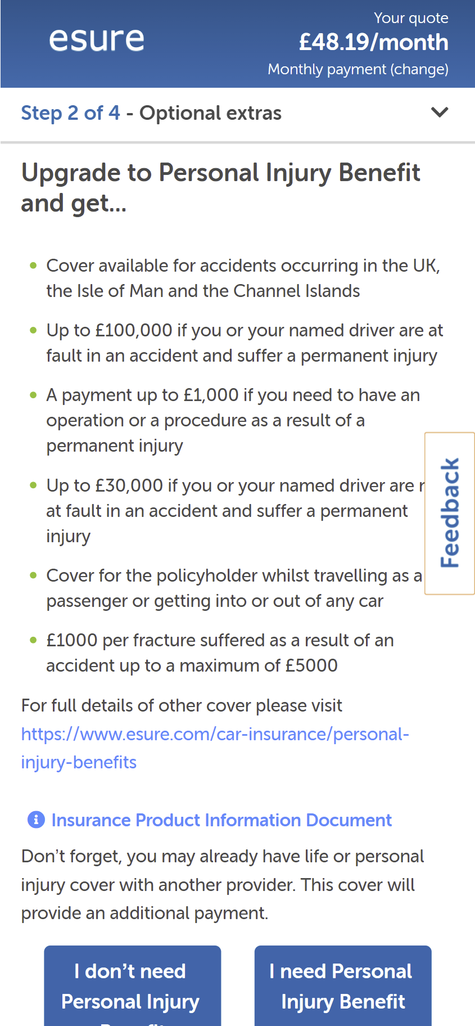
Add-ons – Summary of Current User Journey
Identifying potential opportunities for optimization.
20.5% of mobile users who purchase
12.5% of mobile users who purchase
9.6% of mobile users who purchase
MLP
Car Hire
Personal Injury Benefit
Source: Adobe Analytics, 1st March to 31st May 2021
Notes:
Data for the last 3 months

Slide 13
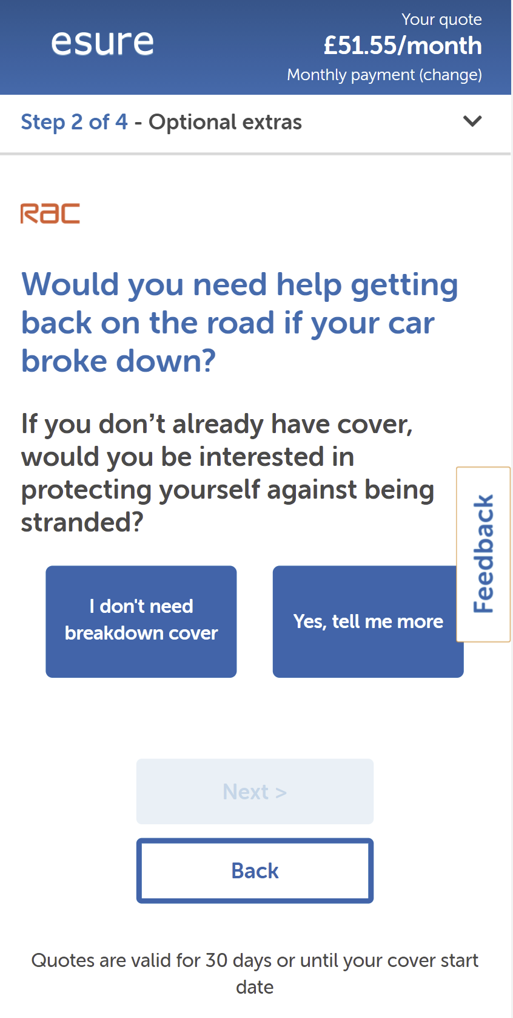
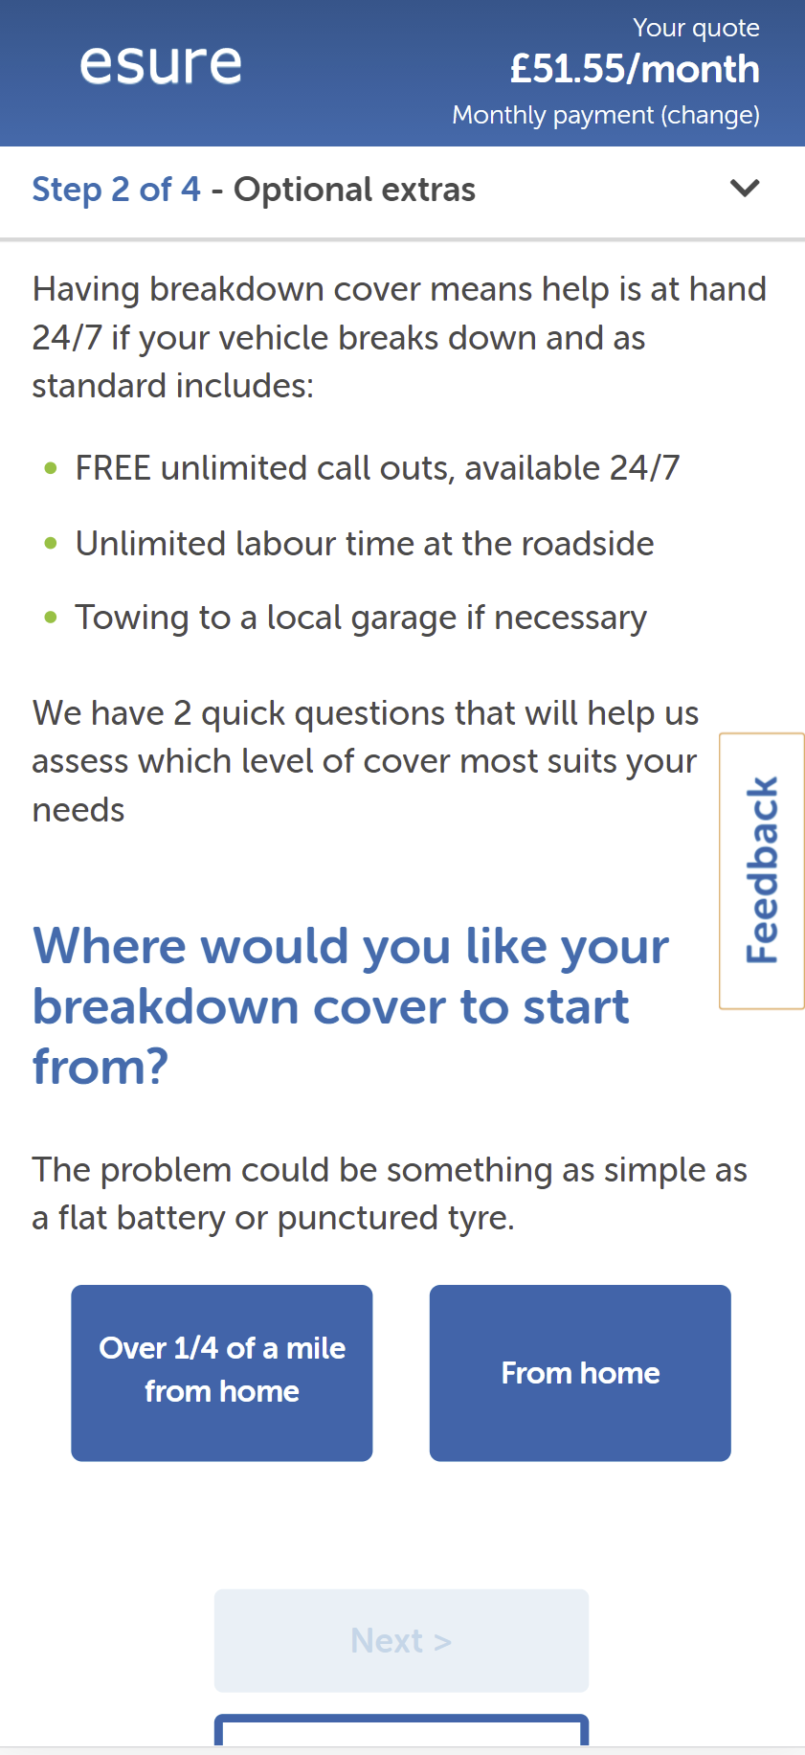
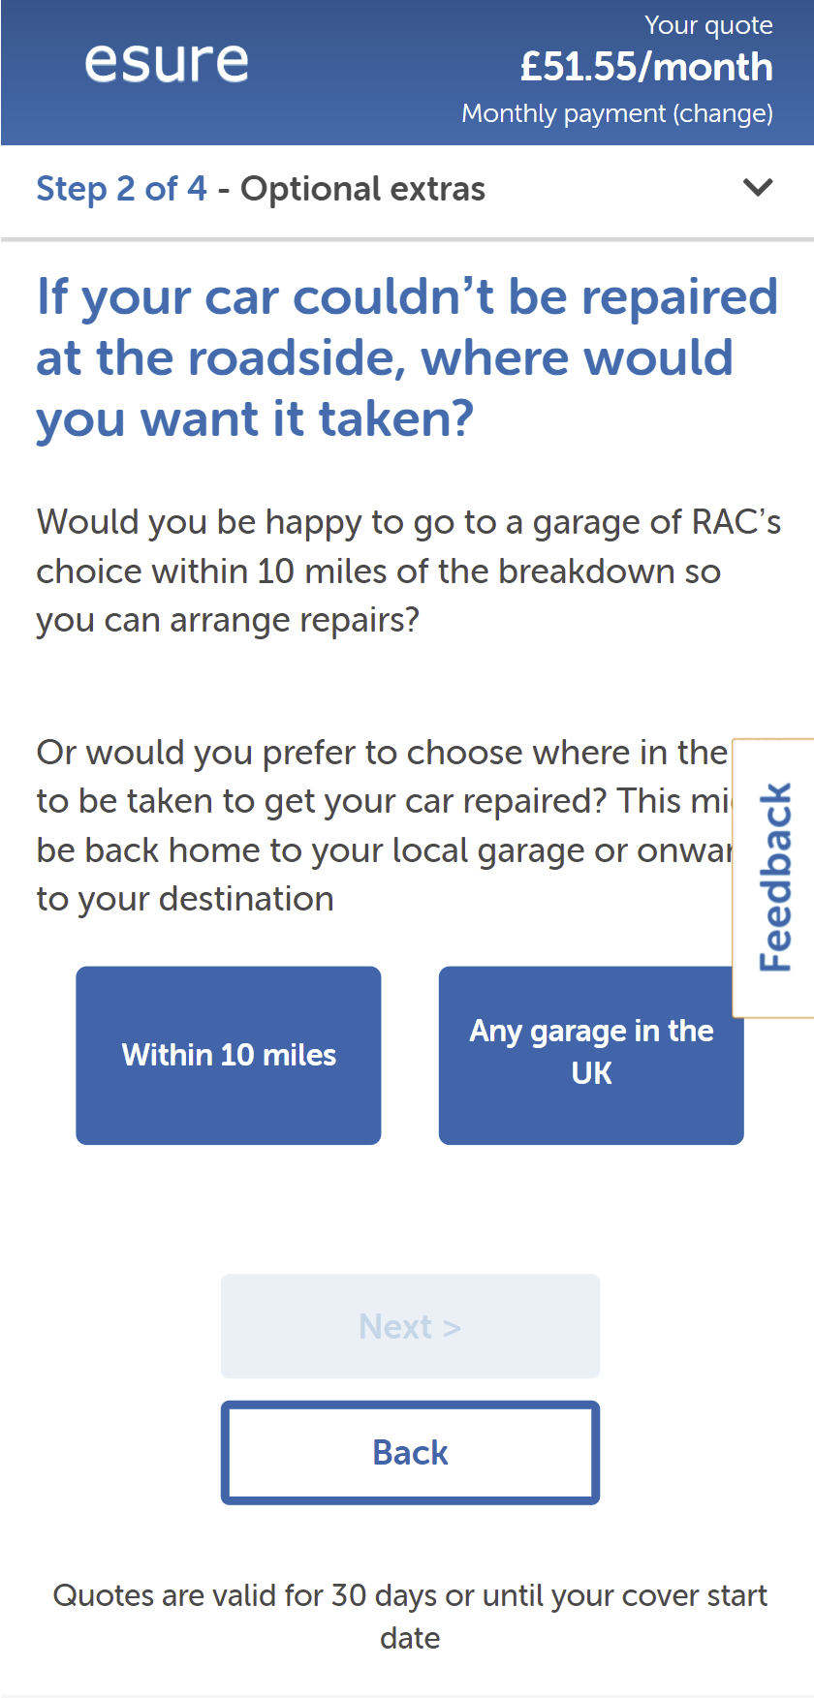
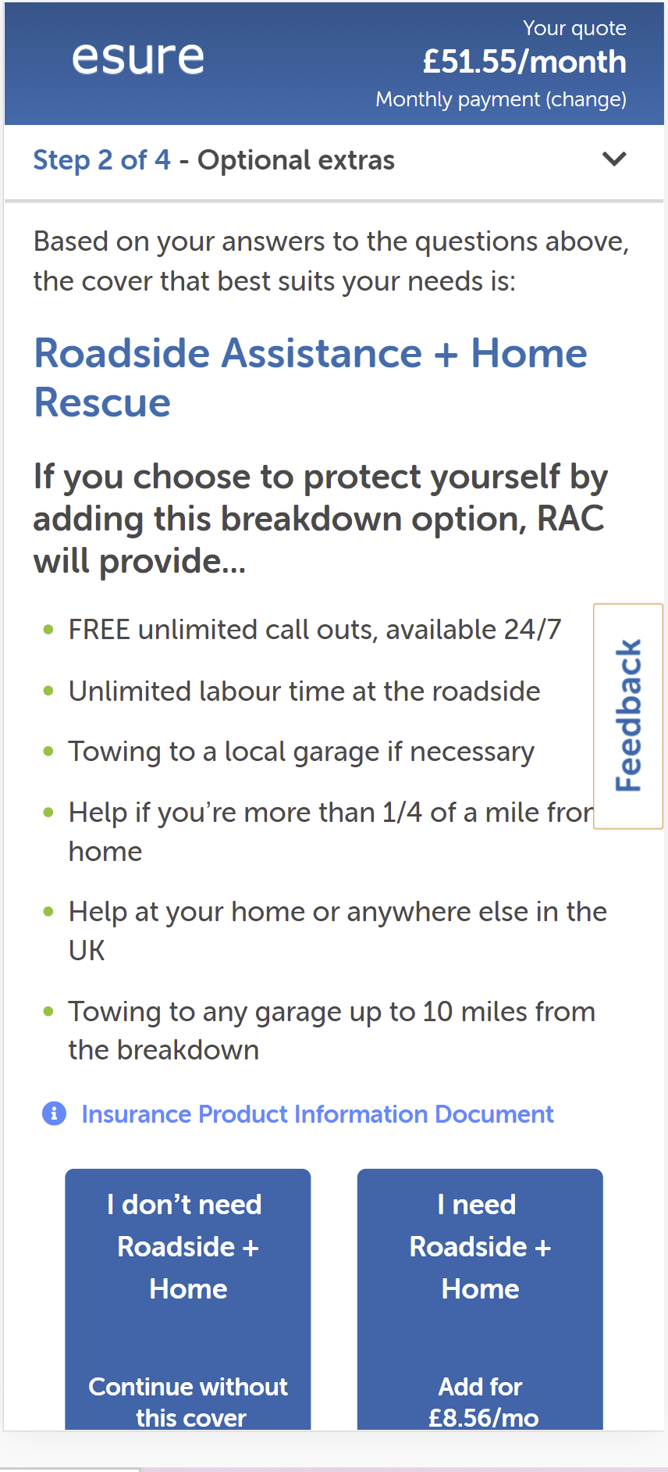
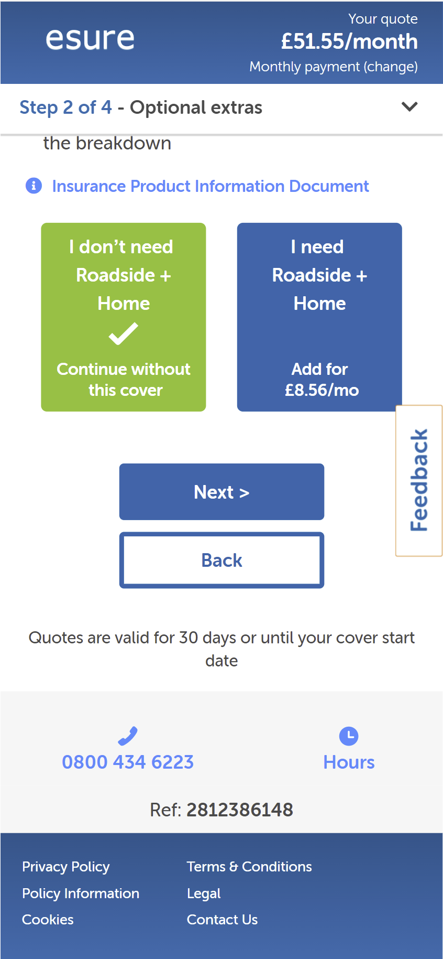
Add-ons – Summary of Current User Journey
2.8% of mobile users who purchase
4.1% of mobile users who purchase
2.2% of mobile users who purchase
Breakdown cover
Source: Adobe Analytics, 1st March to 31st May 2021
Notes:
Data for the last 3 months

Slide 14
Deep Dive into each Add-on

Slide 15
Analysis
Sources of insight.
1.
4.
Competitor analysis
SessionCam research
2.
5.
Interviews with call centre staff
CRO Review
3.
6.
Analytics research
User research

Slide 16
MLP
Add-ons

Slide 17
MLP
Call Centre Objections:
Assumes it is standard.
Have friend who works for legal practice
Confusion about what it covers and what happens if the accident is their fault.
Heuristic Evaluation:
No social proof (e.g. MLP is the most popular add on).
No risk reducer near the CTA (e.g. 14 day cooling off period).
Competing CTAs are identical in shape, size and colour – they lack visual differentiation.

Slide 18
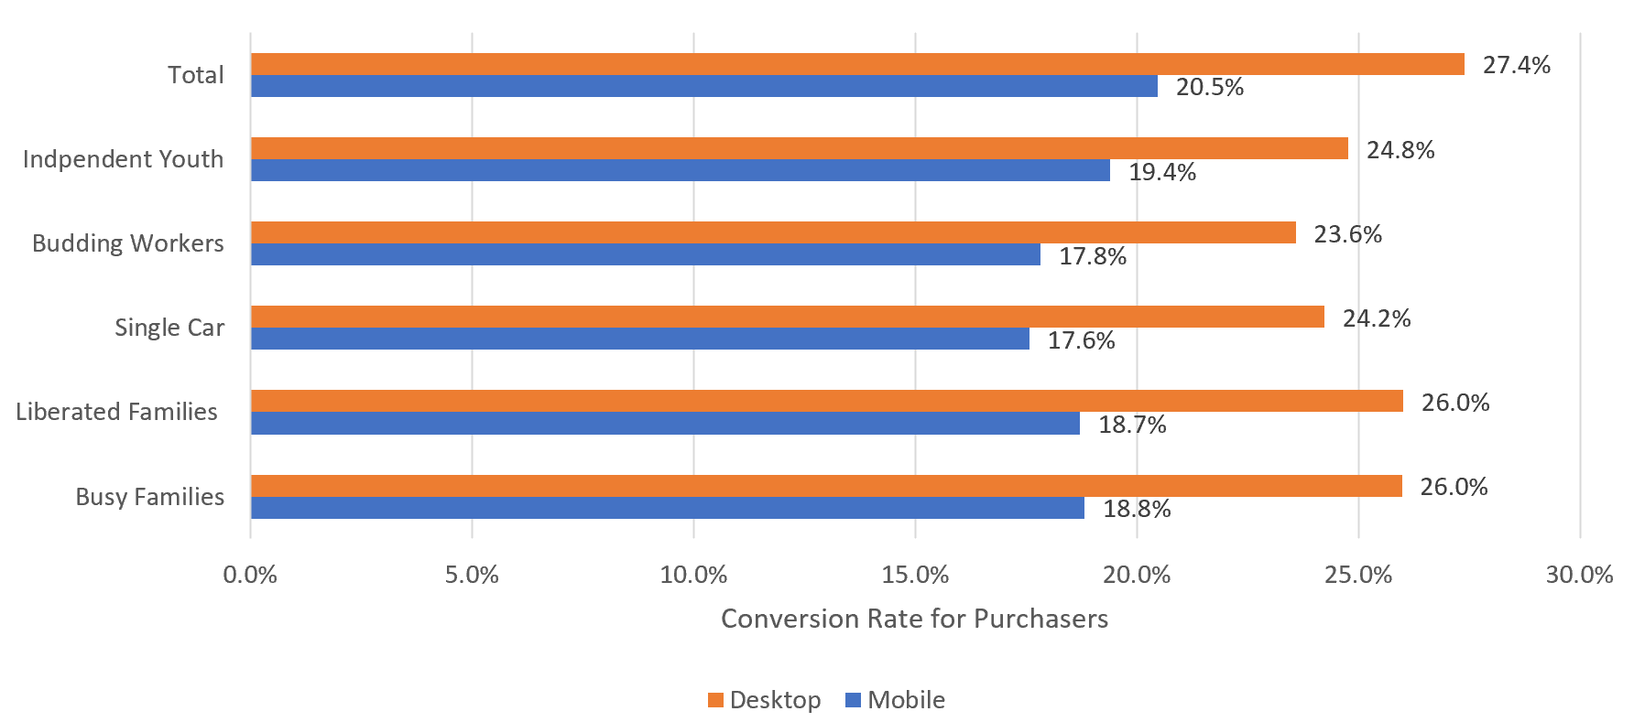
MLP: Conversion Rate by Lifestage Segment:
The difference between mobile and desktop MLP conversion is larger than we expect.
Source: Adobe Analytics, 1st March to 31st May 2021
Notes:
Data for the last 3 months

Slide 19
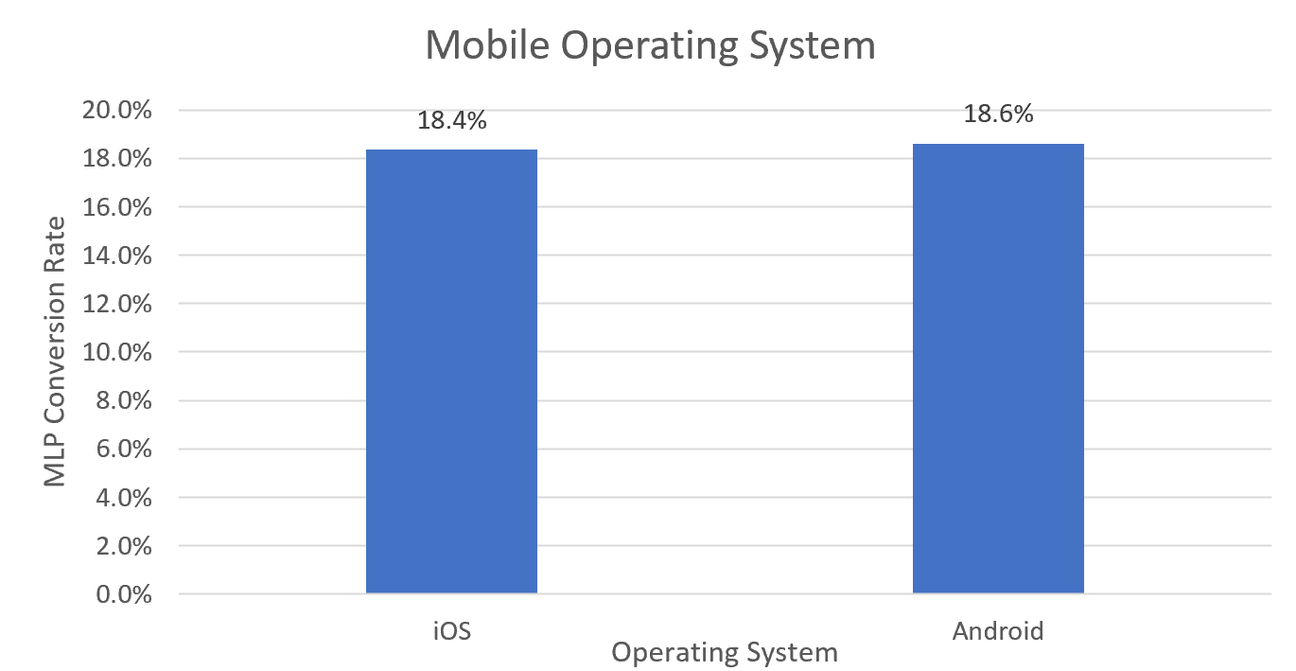
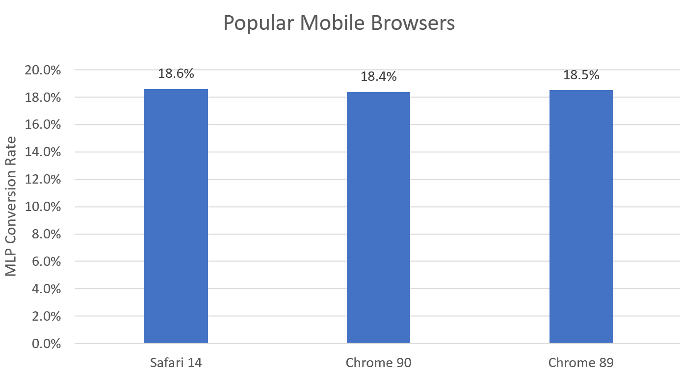
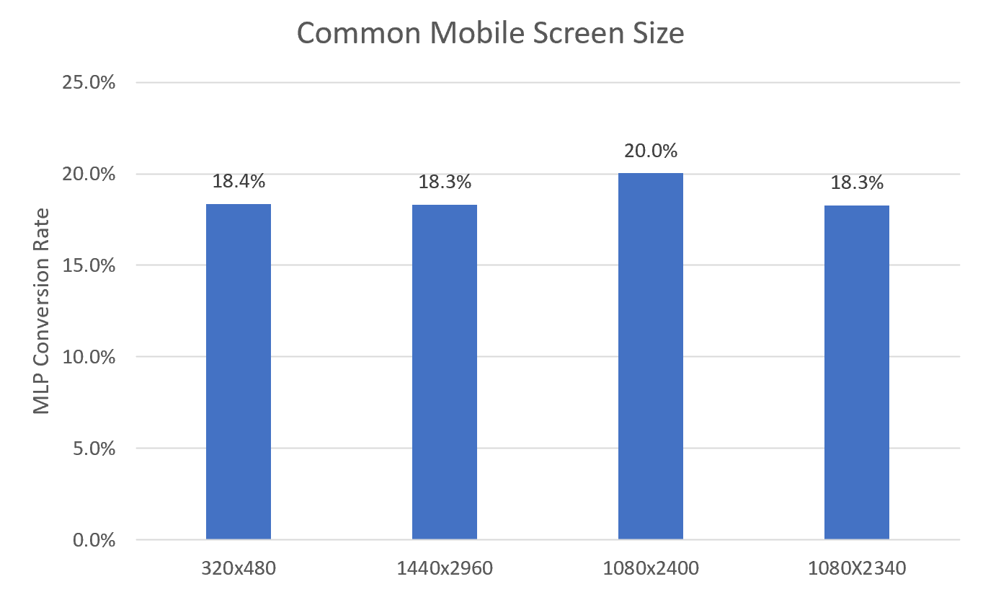
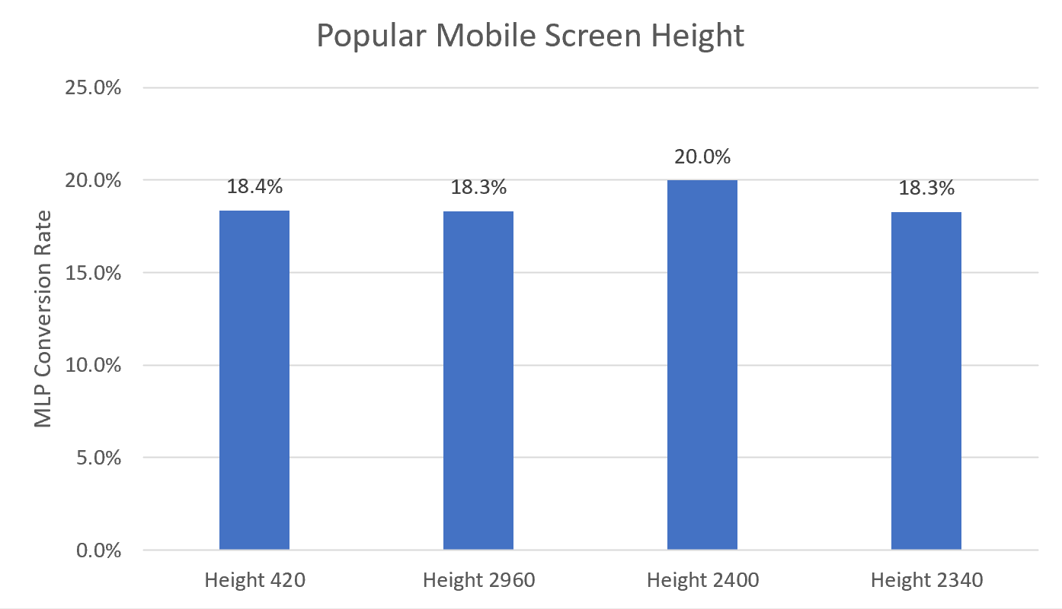
MLP: Conversion Rate of Mobile
The MLP conversion rate on mobile devices is not related to OS, browser, screen size or screen height.
Source: Adobe Analytics, 1st March to 31st May 2021
Notes:
Data for the last 3 months

Slide 20
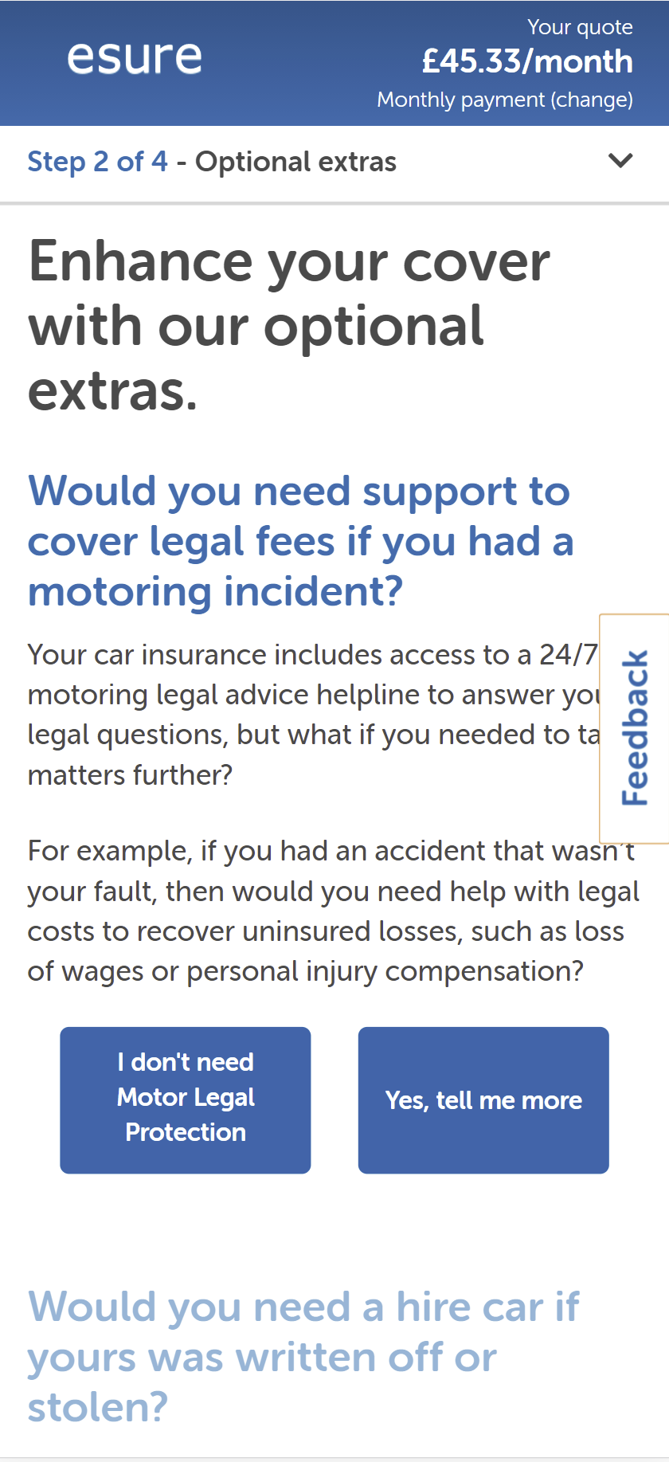
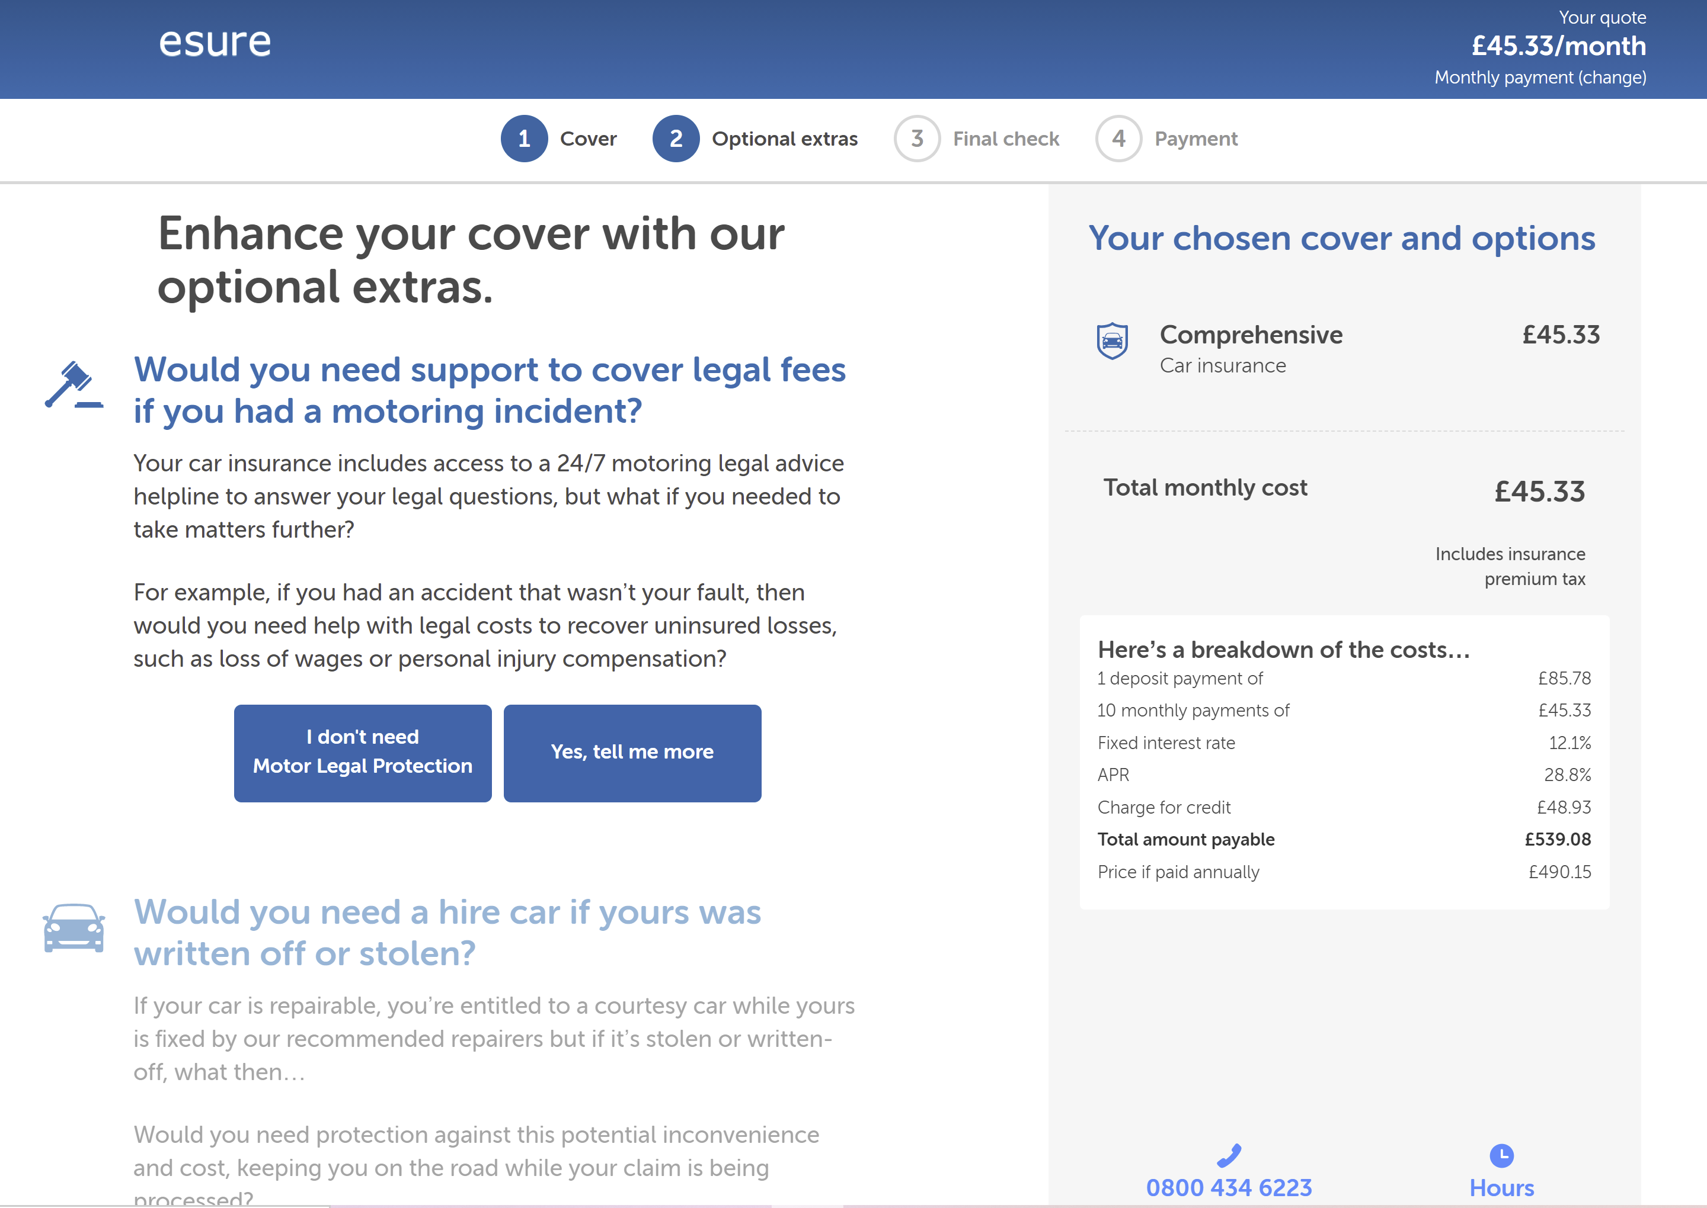
MLP: Why is mobile conversion so low?
Would hiding other add-ons reduce distractions for mobile users?
Progressive disclosure would avoid mobile scrolling down the page to view other add ons.
Notes:
Data for the last 3 months

Slide 21
MLP: User Journey
20.5% of mobile users who purchase
972 Mobile Daily UVs
55% Average CR
Focus user on one add-on at a time.
Personalise according to lifestage segment
Uplift in CR | Days to hit significance
5% | 105
10% | 28
17.5% | 14
Source: Adobe Analytics, 1st March to 31st May 2021
Notes:
Data for the last 3 months

Slide 22
MLP
Summary
Mobile conversion for MLP is much lower than on desktop and needs to be addressed
Most competitors don’t have a button to establish a need
Many users assume MLP is standard
Why are CTAs for don’t need and add cover identical in size, shape and colour?
Other add ons may be a distraction for MLP, especially on mobile where the natural behaviour is to scroll down a page

Slide 23
Car Hire
Add-ons

Slide 24
Car Hire
Call Centre Objections:
Confusion with courtesy car.
Customers think about claims for an accident where car is not written off or stolen.
Heuristic Evaluation:
Displaying the RAC logo on Breakdown increased the take up rate.
The copy immediately after the headline reinforces the perception that a courtesy car will be on offer. Users may not read the second part of the sentence. Could reversing the order of the copy influence take up?
Notes:
User testing insight: 2d. The difference between Courtesy Car and Hire Car was unclear for approx. 11/12 participants. People believed these two concepts were the same, and consequently were disappointed as this was advertised as part of the policy for free. It was not until further inspection that two participants understood the difference, while the rest were still unsure. Points of confusion like this are small, but enough to make esure appear untrustworthy or put off Researchers who would opt for a policy with everything included.

Slide 25

User testing insights
Pain point
Severity
2d. The difference between Courtesy Car and Hire Car was unclear for approx. 11/12 participants. People believed these two concepts were the same, and consequently were disappointed as this was advertised as part of the policy for free. It was not until further inspection that two participants understood the difference, while the rest were still unsure. Points of confusion like this are small, but enough to make esure appear untrustworthy or put off Researchers who would opt for a policy with everything included.
SEVERE

Slide 26
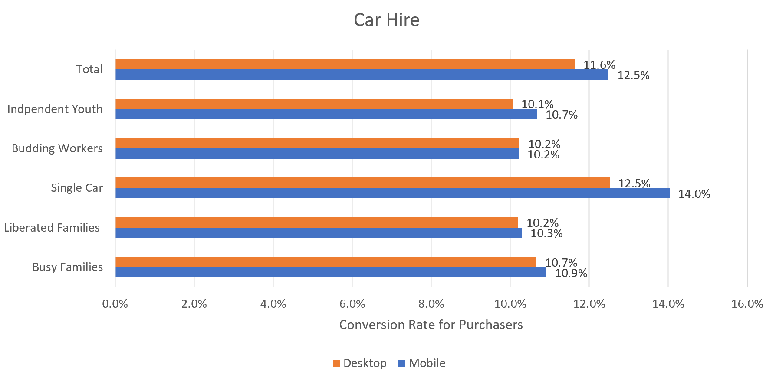
Car Hire: Conversion Rate by Lifestage Segment
Single car households are significantly more likely to add car hire cover.
Source: Adobe Analytics, 1st March to 31st May 2021
Notes:
Data for the last 3 months

Slide 27
Car Hire
Summary
Confusion with courtesy car.
Lifestage segment is a strong indicator of whether users will add car hire (e.g. single car households).
Displaying the logo for Enterprise Rent-a-Car could build credibility and appeal.

Slide 28
Personal Injury Benefit
Add-ons

Slide 29
Personal Injury Benefit
Call Centre Objections:
No win – no fee - often mentioned.
Don’t consider if the accident is their fault and someone is seriously or permanently injured.
Heuristic Evaluation:
The language on the CTA lacks a strong action verb (e.g. Get Personal Injury Benefit).
The title and paragraph are not compelling and don’t mention the add on product.
Could use lifestage segments to personalise the user experience for customers with a high propensity to need PIB.

Slide 30
User testing insights
Pain point
Severity
2e. Add-on description text is lengthy and unclear. The current content and layout does not serve any persona particularly well and competitors were ranked 23% higher than esure in terms of clarity. For example, the Personal Injury Benefit description repeats the same question: Title: “Would you need extra financial support if you were seriously injured in an accident?” Description: “Your core policy provides limited payments in the evident of a personal accident or medical expenses, but if you were involved in a motoring incident, would you need enhanced compensation?” The add-ons lead with lengthy sentences, instead of concise and scannable bullet points. The benefits are not revealed until users click ’Find out more’, which are likely to be a more compelling argument.
HIGH

Slide 31
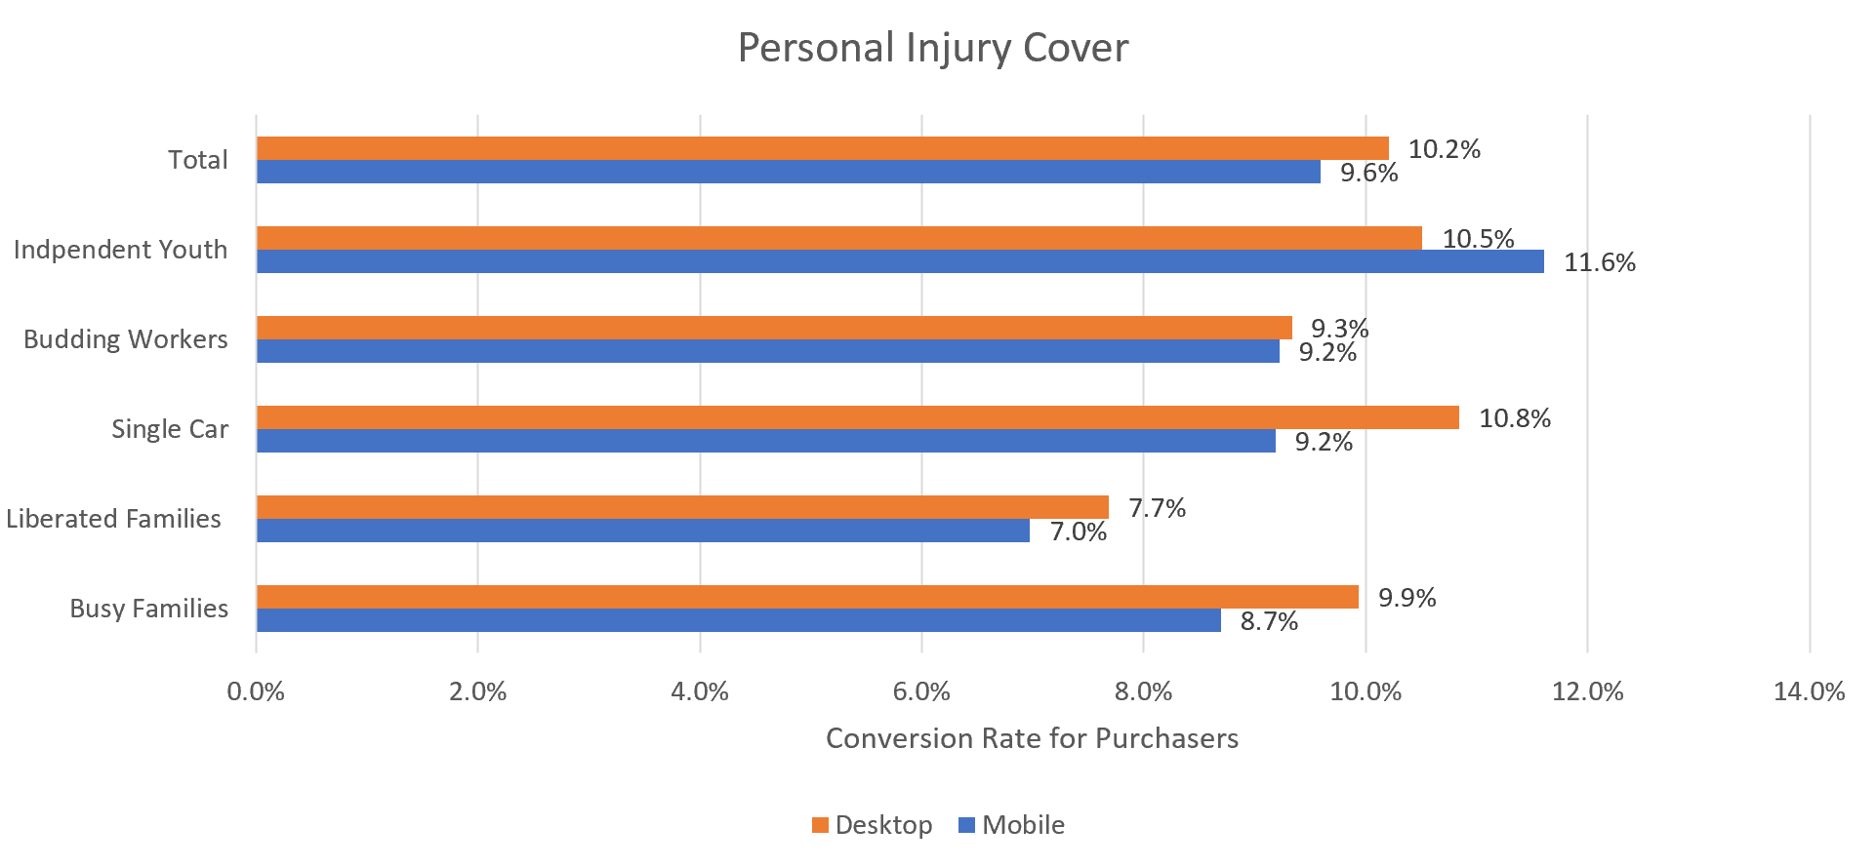
Personal Injury Benefit: Conversion Rate by Lifestage Segment
Younger segments are significantly more likely to add personal injury benefit.
Source: Adobe Analytics, 1st March to 31st May 2021
Notes:
Data for the last 3 months

Slide 32
Personal Injury Benefit
Summary
Low understanding of what PIB covers.
Customers often don’t consider what if the accident is their fault or the possibility that someone might be seriously injured.
“Enhanced compensation” is not sufficiently compelling language.
CTA wording lacks a strong action verb.

Slide 33
Breakdown Cover
Add-ons

Slide 34
Breakdown Cover
Call Centre Objections:
Bank account provides breakdown cover – may not be equivalent.
Cover is expensive compared to buying it direct.
Heuristic Evaluation:
Branding of RAC is minimal and not persistent throughout the journey.
No risk reducer on CTAs (e.g. 14 day cooling off period).

Slide 35
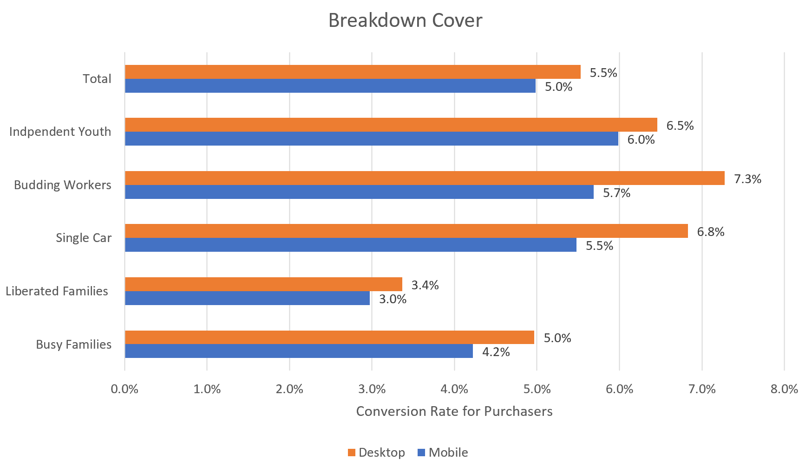
Breakdown Cover: Conversion Rate by Lifestage Segment
Lifestage segment is a significant driver of propensity to add breakdown cover.
Source: Adobe Analytics, 1st March to 31st May 2021
Notes:
Data for the last 3 months

Slide 36
Breakdown Cover
Summary
Perceived as expensive by call centre staff.
Branding of RAC is minimalistic and is not consistent throughout the journey.
No risk reducer near CTAs - e.g. Pay nothing if you cancel before 14 days.
Lifestage segment is a strong determinant of add on take up.

Slide 37
Decision Style
How do customers choose brands?

Slide 38
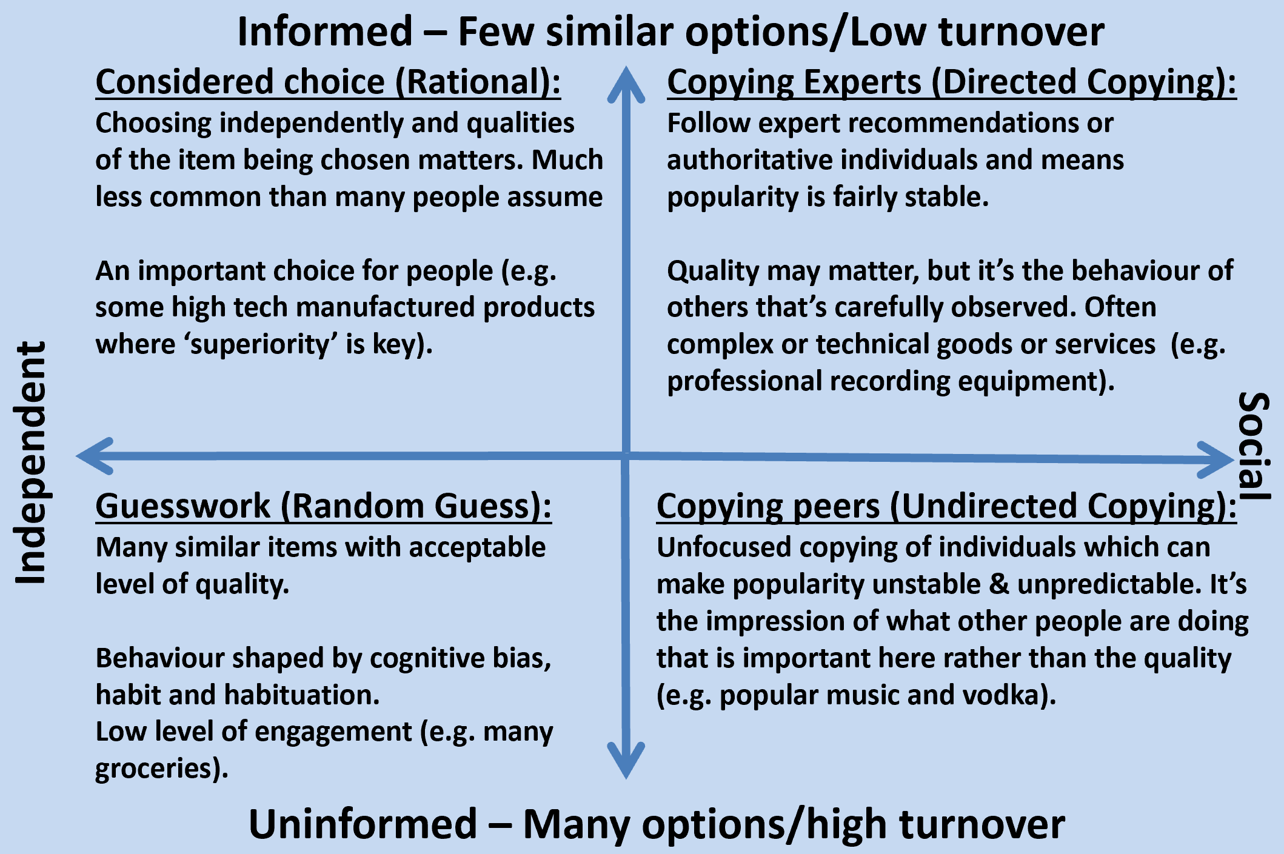
What is the most common decision style?
Research by marketing expert Mark Earls and social scientist identified four different decision styles which directly influence how people respond to how choices are presented to them:
Source: I’ll Have What She’s Having – Alex Bentley, Mark Earls & Michael J. O’Brien and Copy,Copy,Copy by Mark Earls

Slide 39
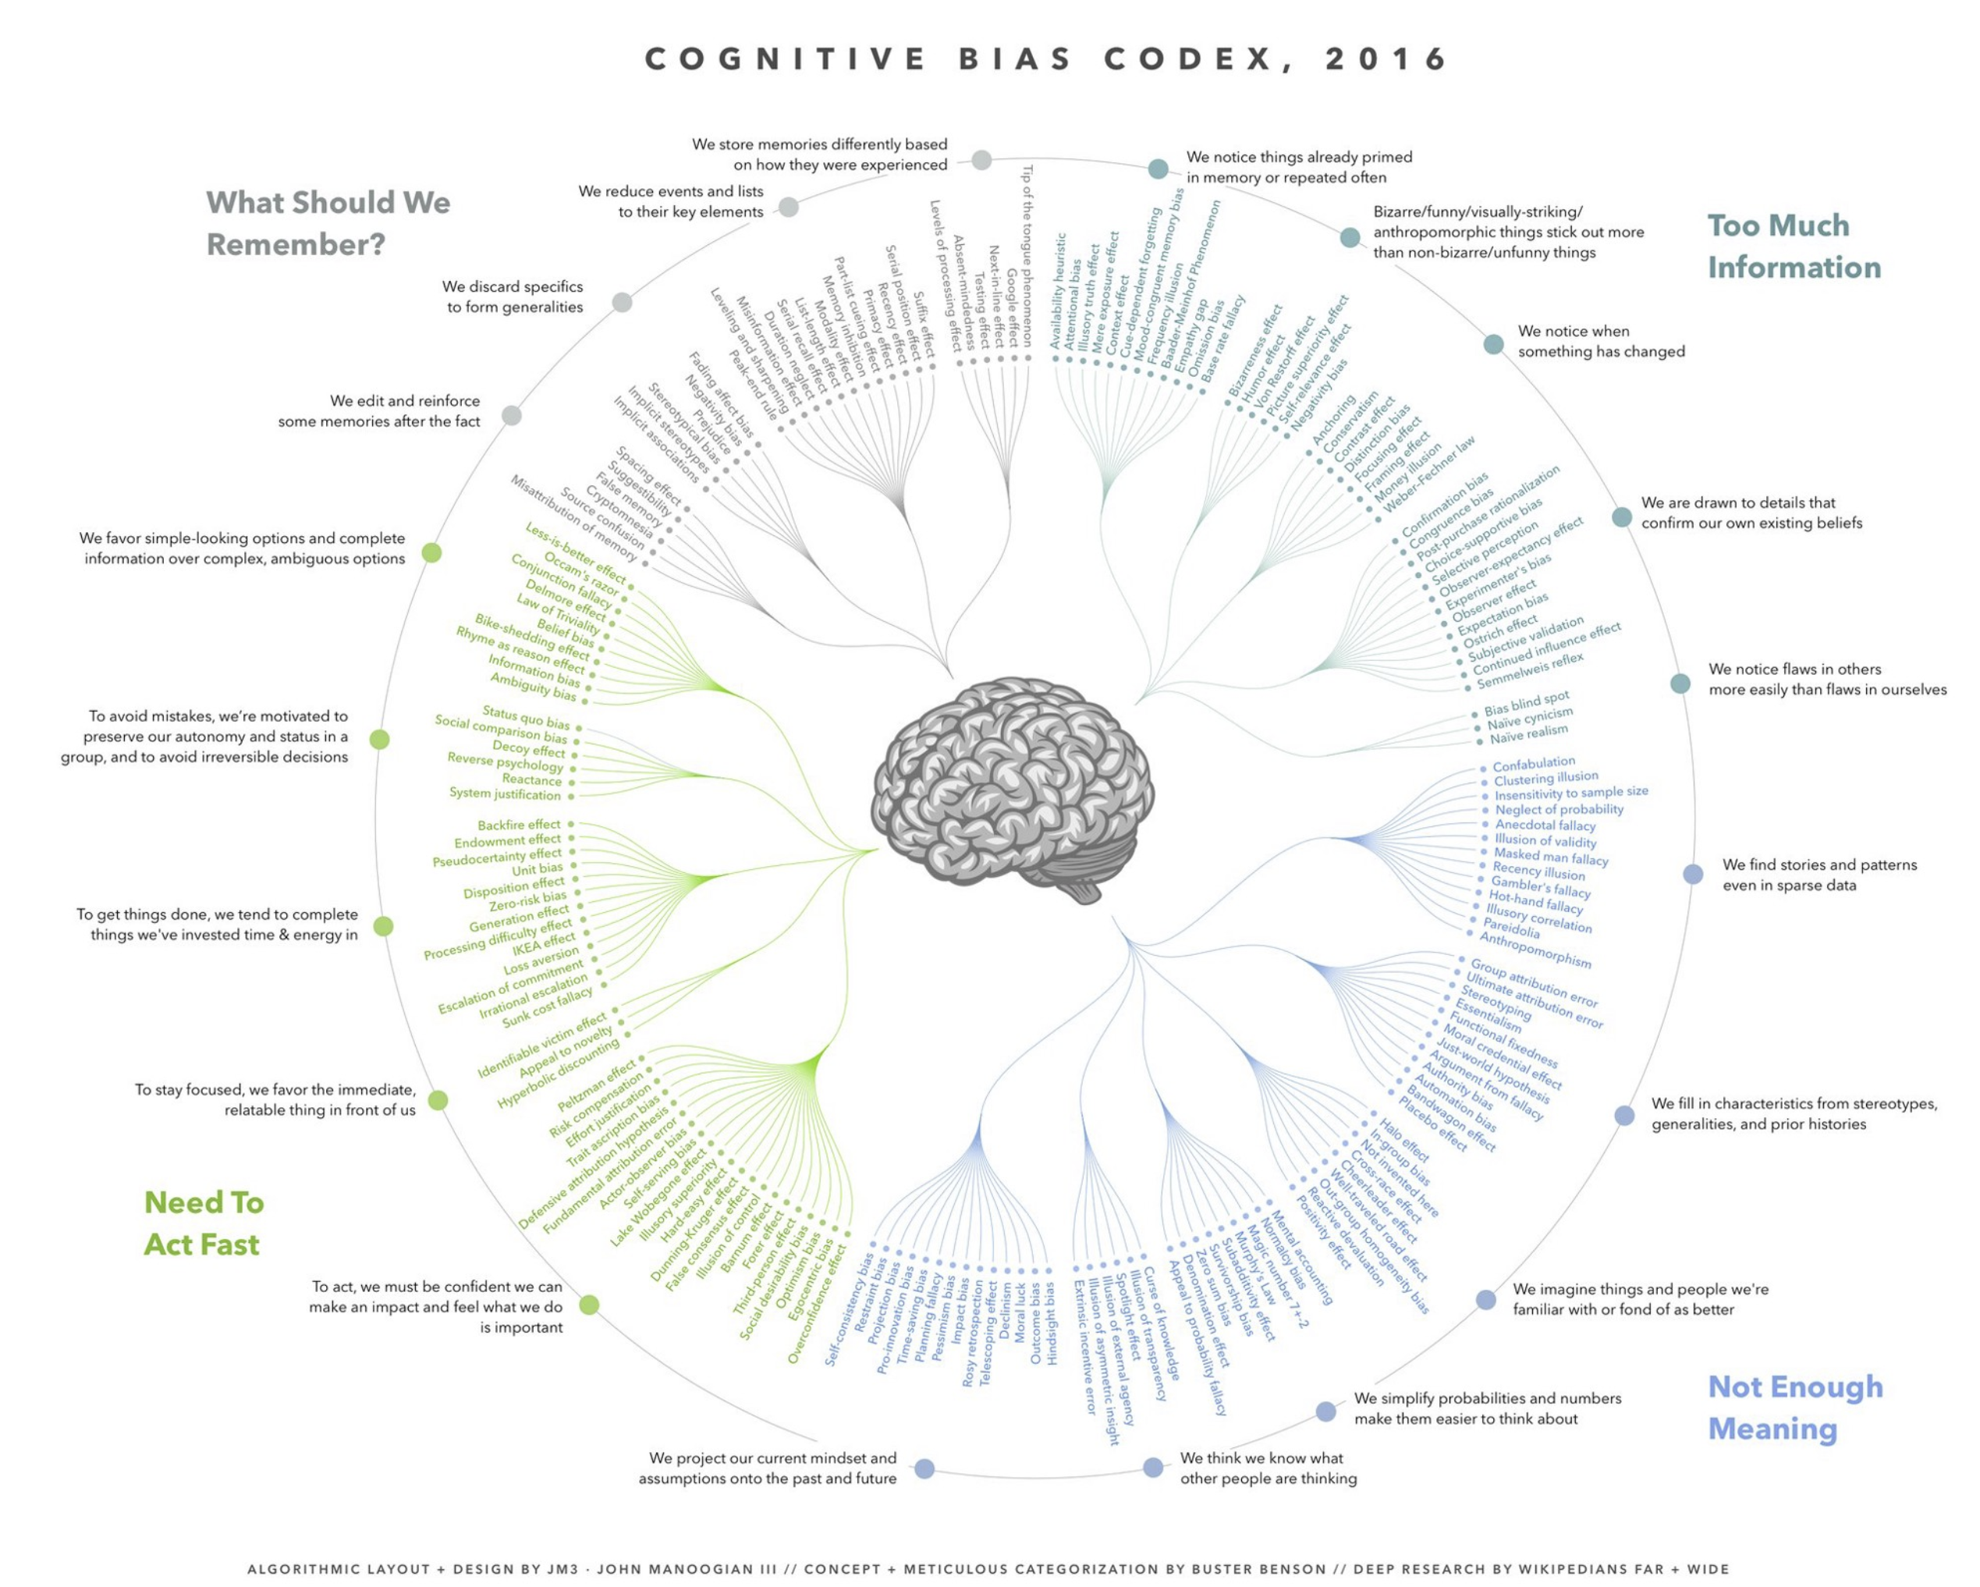
Over 170 cognitive biases can be used in experiments
Source: https://cdn-images-1.medium.com/max/2000/1*71TzKnr7bzXU_l_pU6DCNA.jpeg

Slide 40
Decision Style
Summary
People are not fully rational and use short-cuts to make decisions when they are unable to evaluate more than a few product offerings.
Customer decision styles can be used to identify opportunities for potential A/B tests.
Customer decision styles heavily influence the effectiveness of different marketing strategies and test ideas.

Slide 41
Add-ons
1.
Closing the gap between desktop and mobile MLP conversion rate.
Priorities for testing.
2.
Improving the clarity of copy for each add on to enhance comprehension.
3.
Create more compelling and persuasive copy for each add on.

Slide 42
Add-ons
Ideation session – next week
Agree key areas of testing focus
Agree support required from REO
Next steps

